Slide 1

Econometric Property Investment Calculator
Troy Bailey, Seth Bitney, Kat Pin, Valerie Wilmot, Yuta Yamaguchi

Slide 2







Data Sources
Zillow
City of
Austin
School Digger
US Census Bureau
Texas School Guide
OpenStreetMap

Slide 3
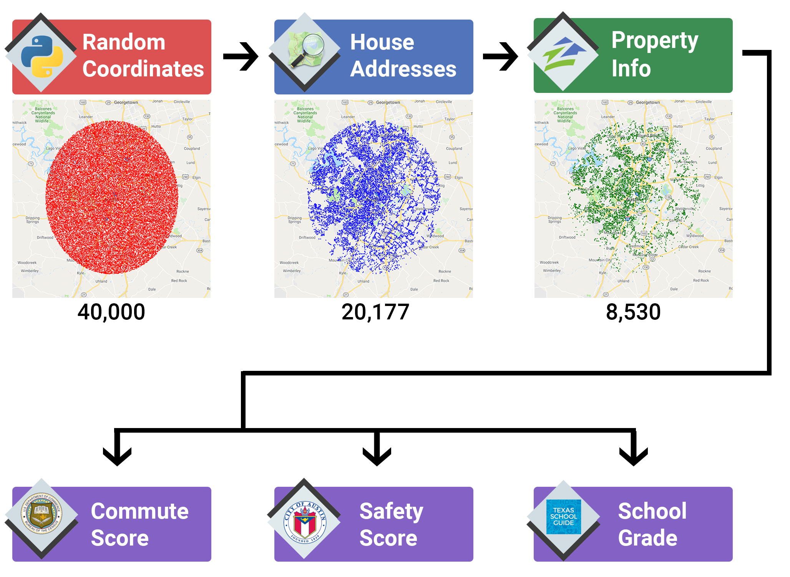
Data Exploration
& Cleanup
Notes:
- Defined city center as Texas State Capital building
- Set radius of 20 miles
Generated 40,000 random geocoordinates
modules used:
random
Math
output to: randomLatLon.csv
- Used randomLatLon.csv
- Queried GeoPy Nominatim API for residential addresses
Cleaned data for further analysis
modules used:
geopy
Time
output to:
addressList.csv
- Used addressList.csv
- Queried Zillow API using PyZillow module for valuation and sqft
- Cleaned data for further analysis
modules used:
pyzillow
GetDeepSearchResults
output to:
masterData.csv

Slide 4
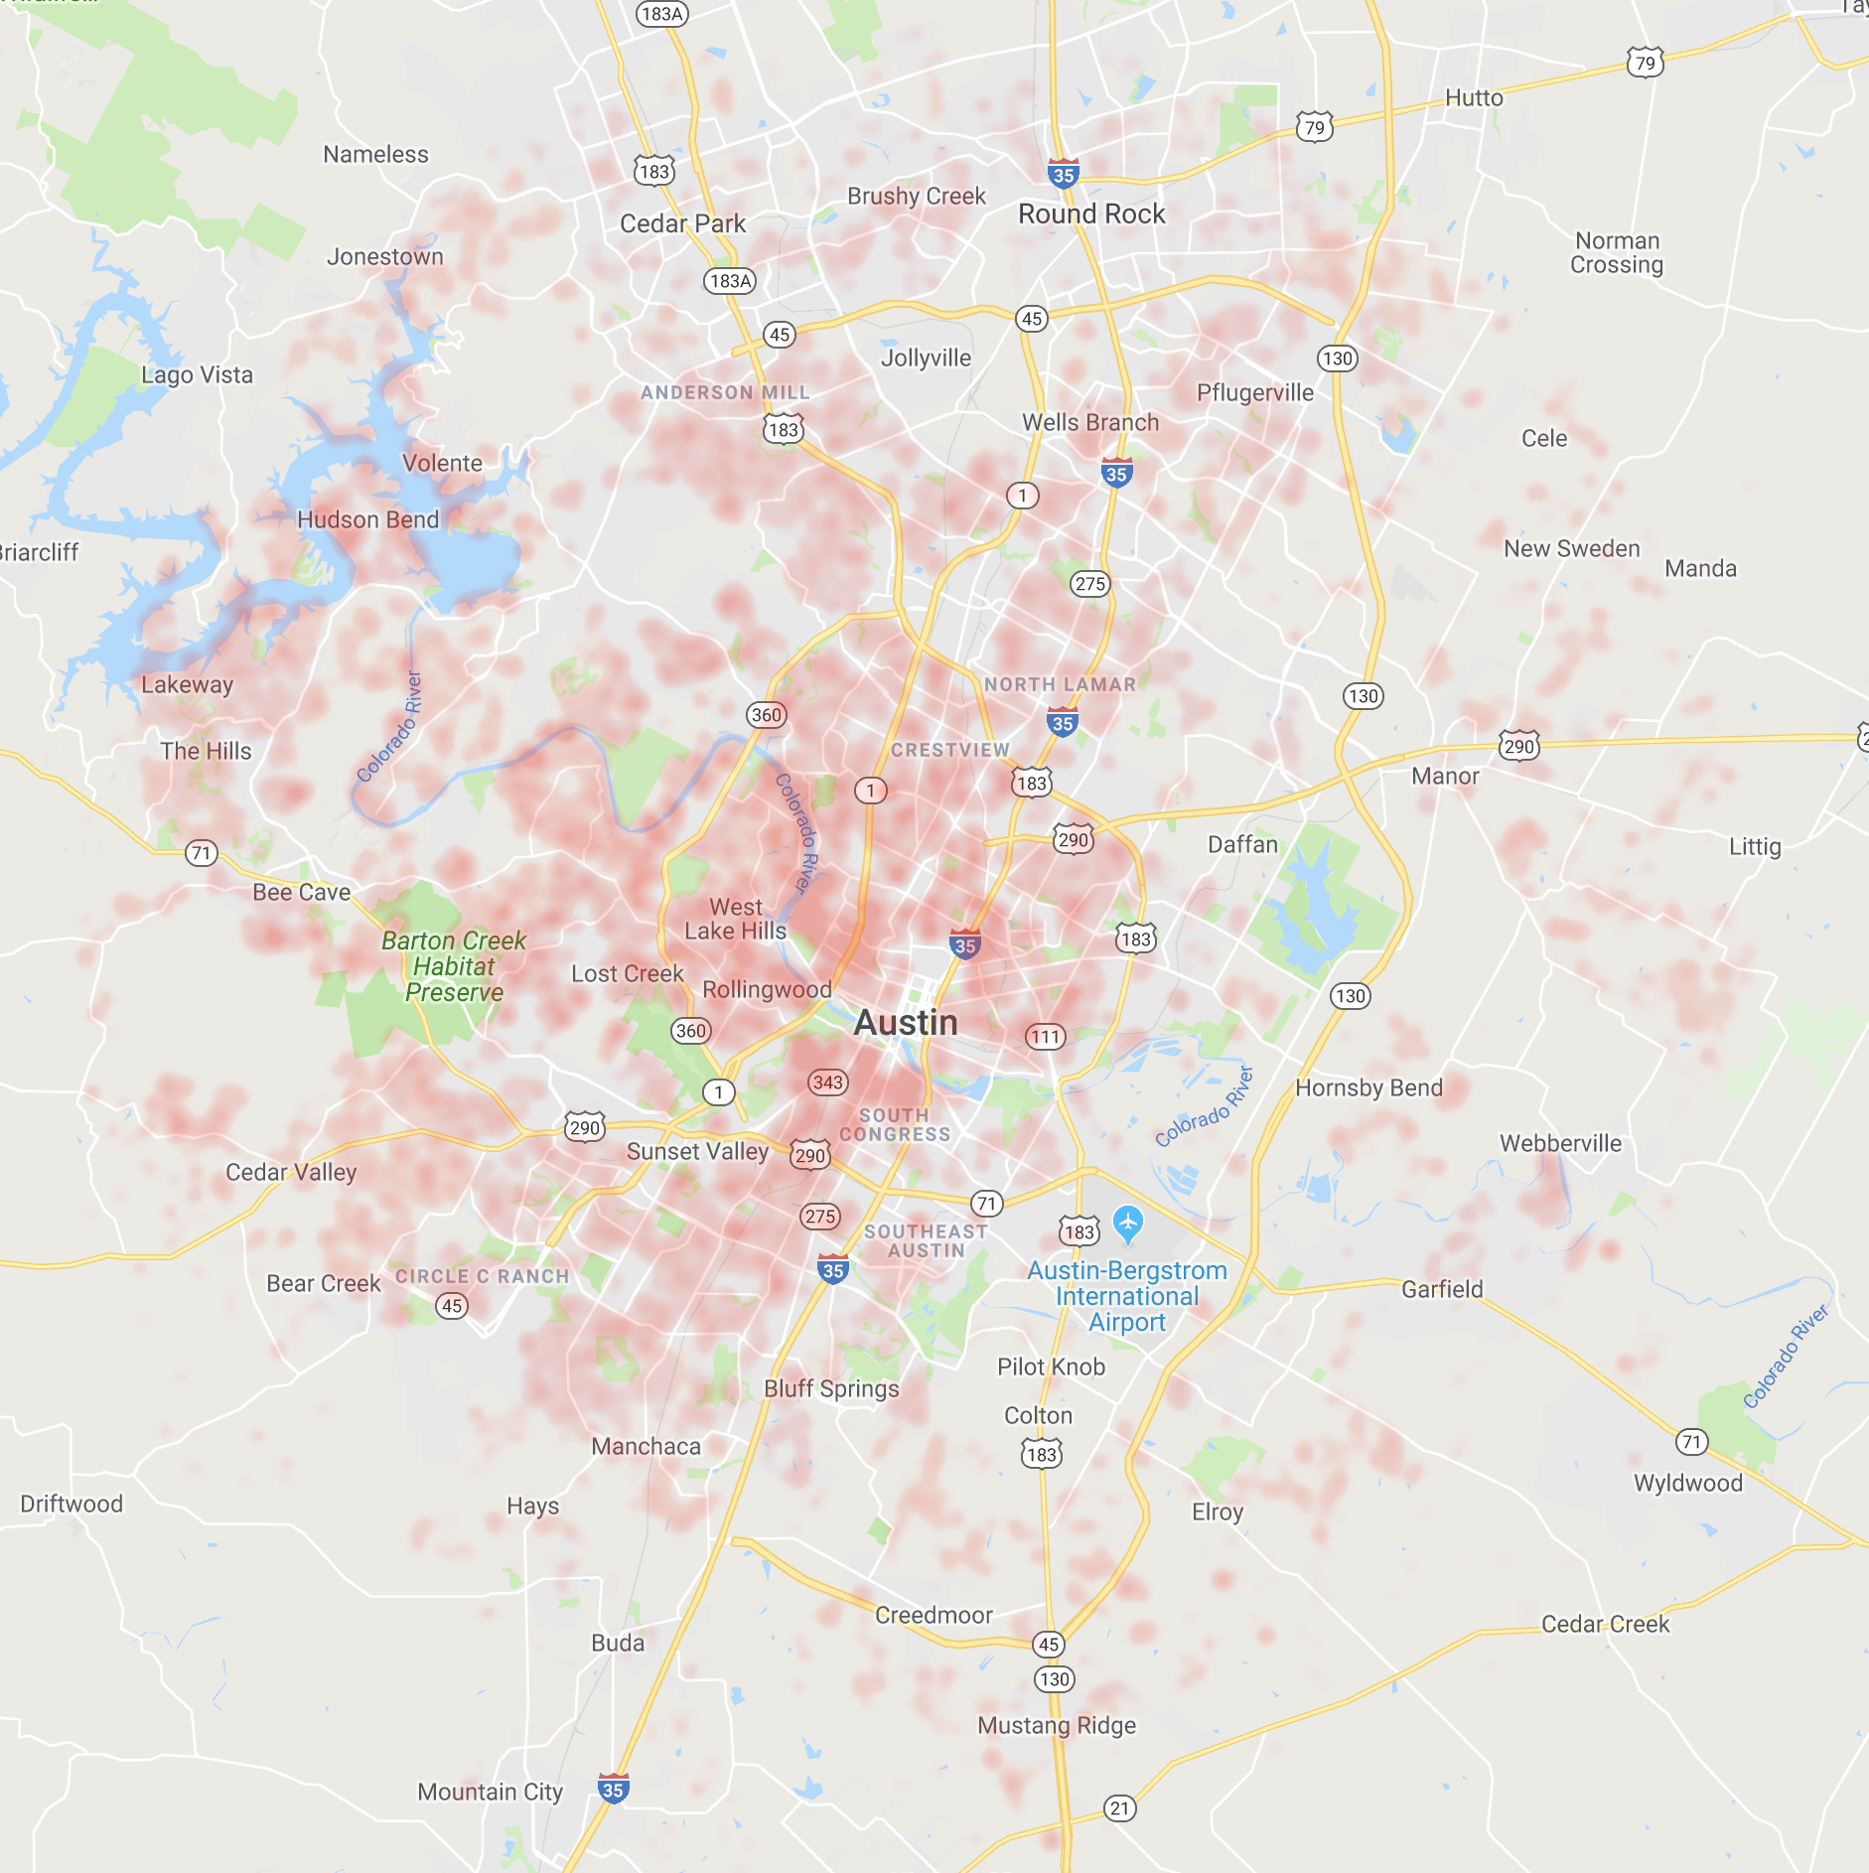
Property Value
Cheap
Expensive

Slide 5
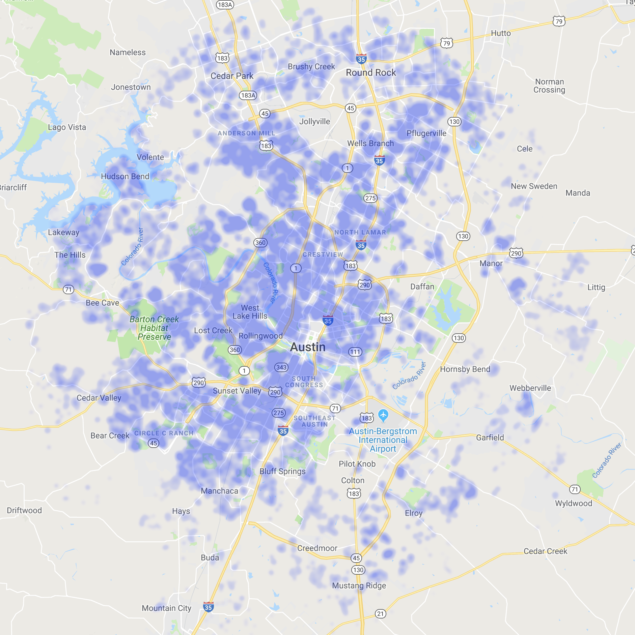
Commute Score
Long
Short

Slide 6
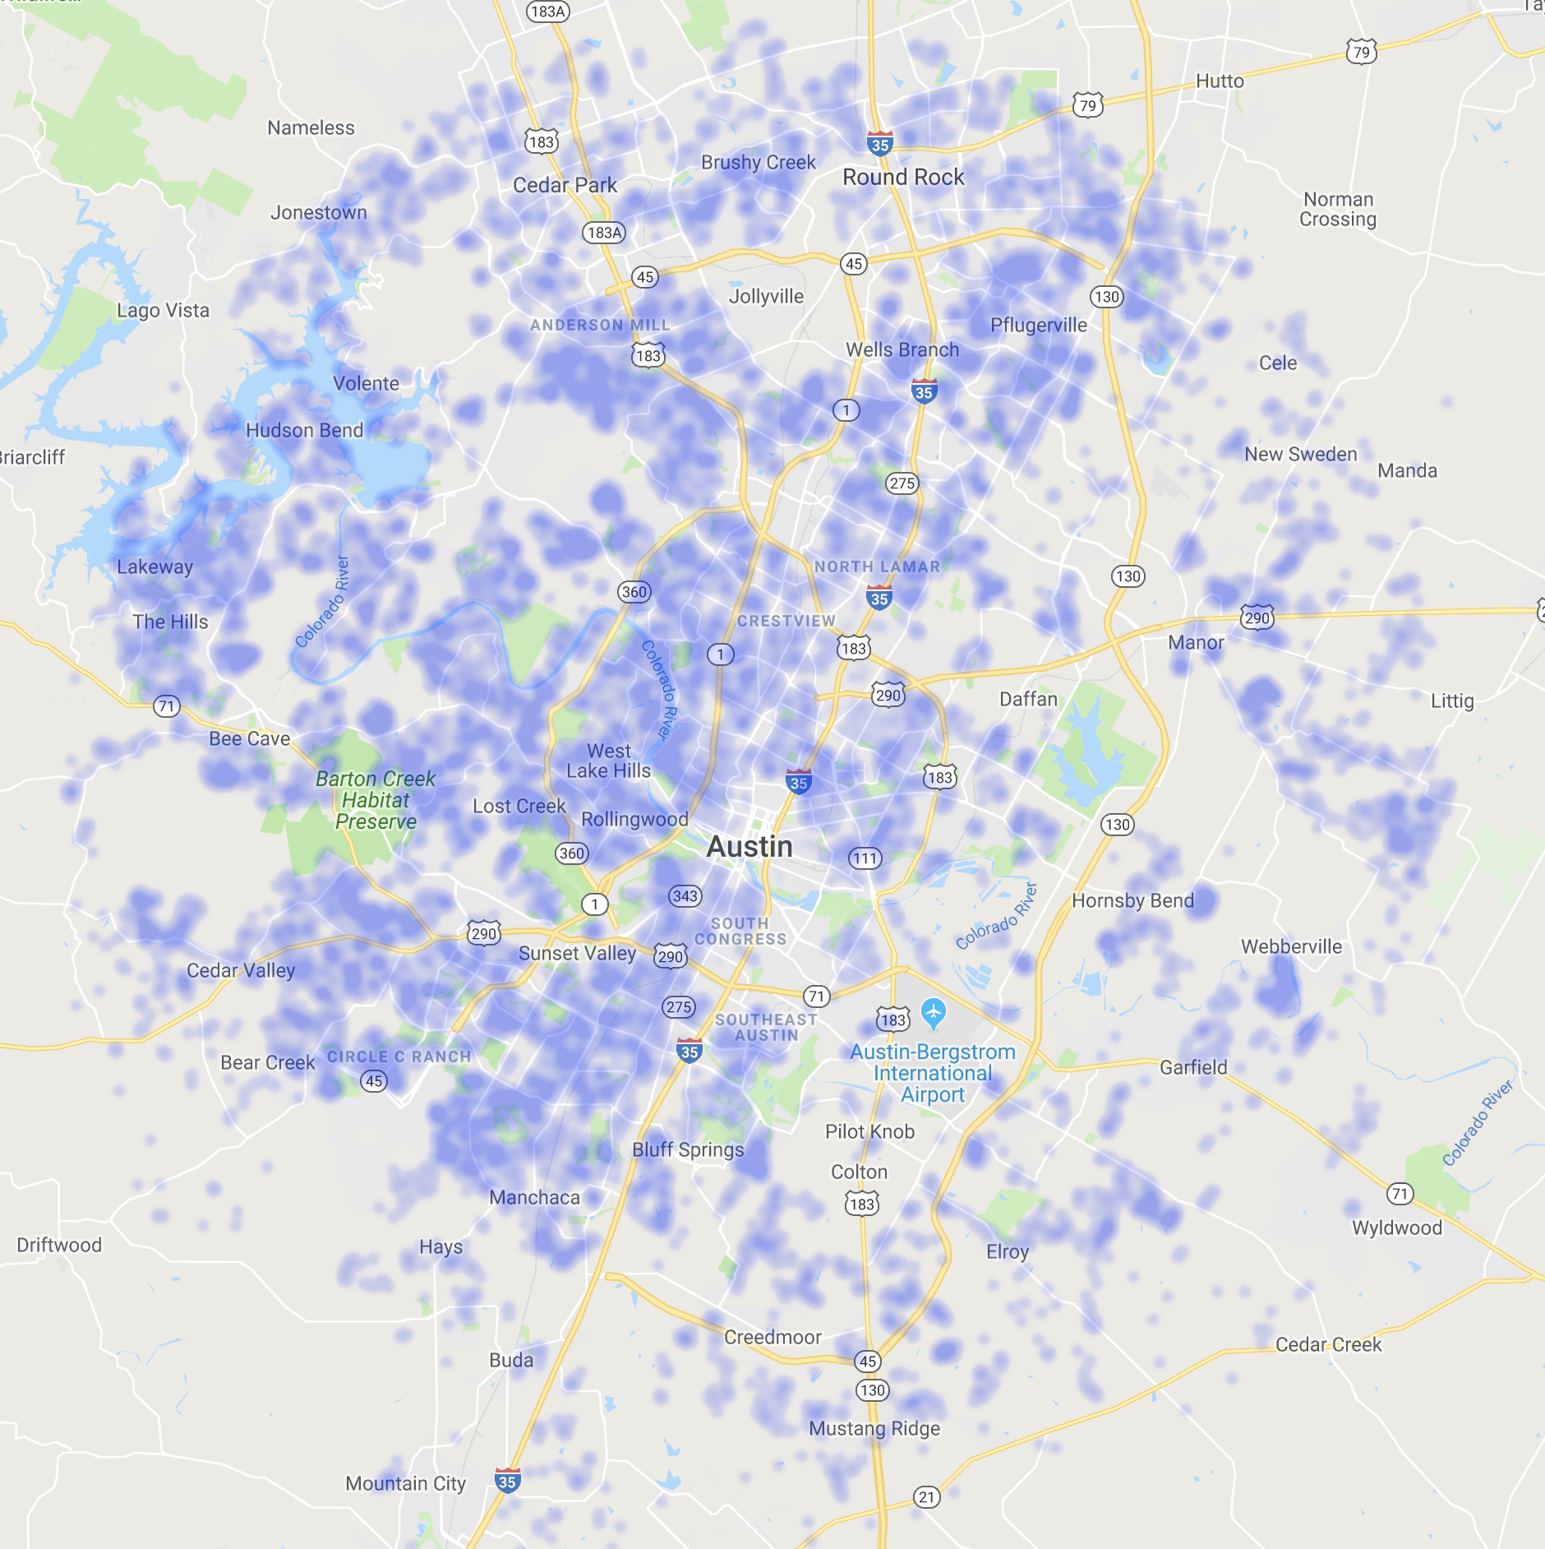
Safety Score
Unsafe
Safe

Slide 7
School Grade
Insert new heat map here with same dimensions
Low
High

Slide 8
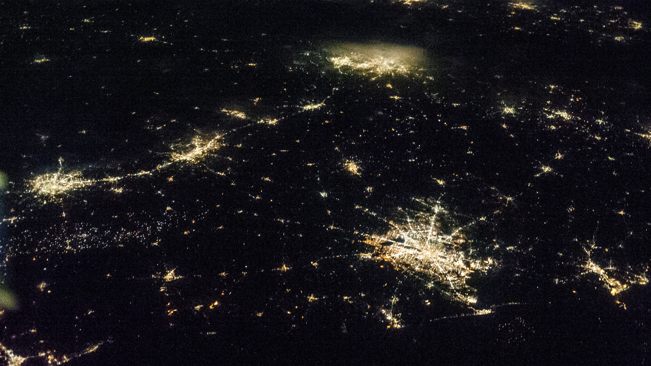
Analysis

Slide 9
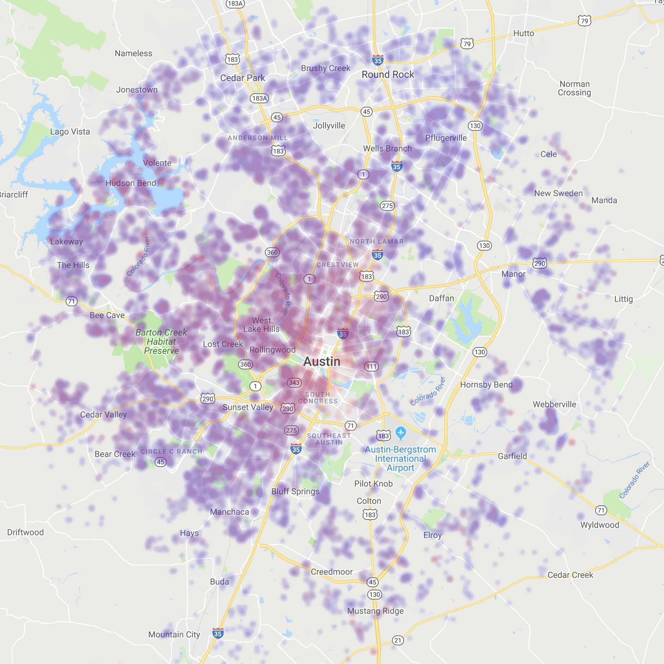
Crime vs Property Value
Property value does not take into account crime risk

Slide 10
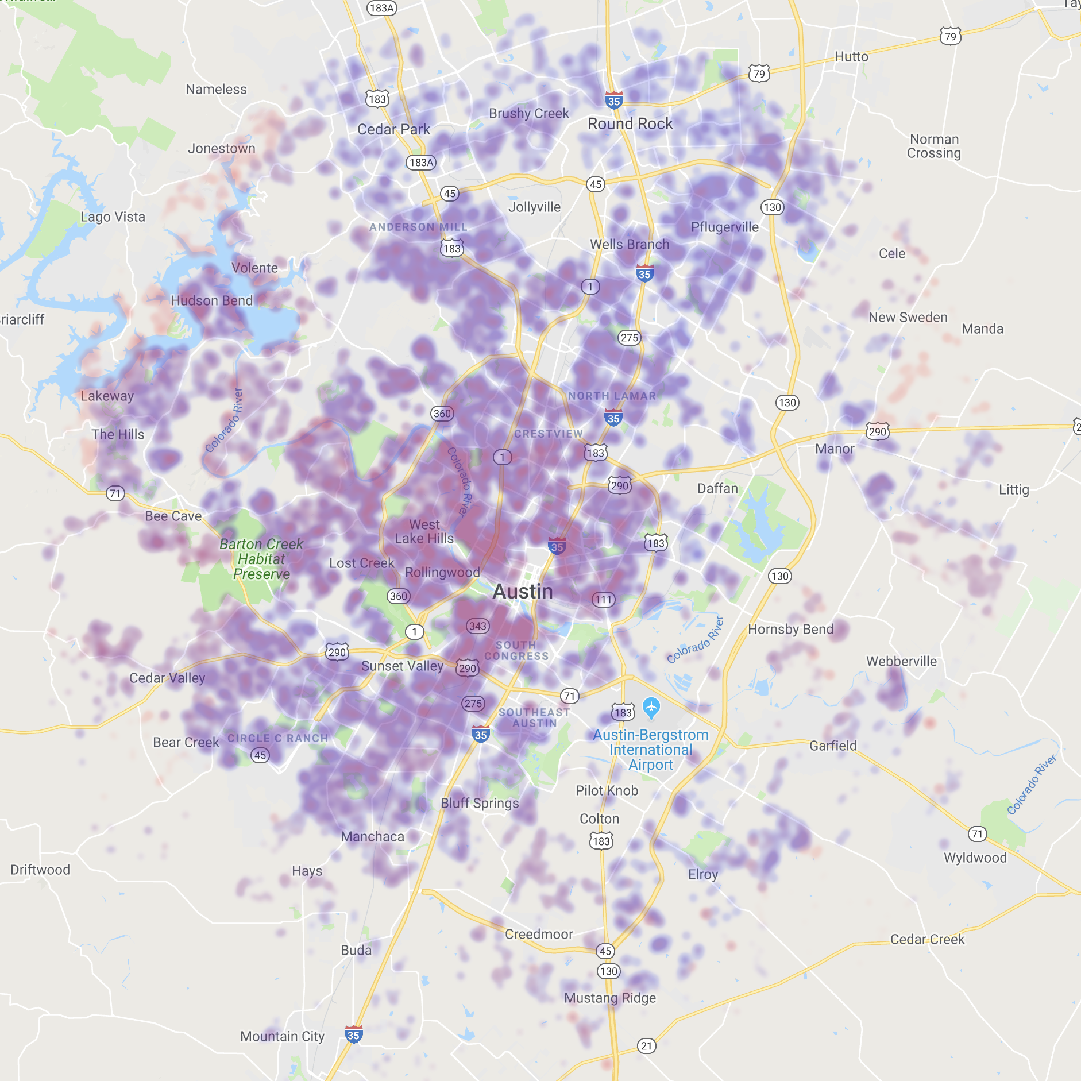
Commute vs Property Value
Property values and commute align with locations of big companies (galleria, downtown, northwest (Dell, GM, etc))

Slide 11
School Grade vs Property Value
Insert finding here

Slide 12





Really EPIC Team
Troy Bailey
Seth Bitney
Kat Pin
Meet the Team 05 peeps
Valerie Wilmot
Yuta Yamaguchi

